Slide 1

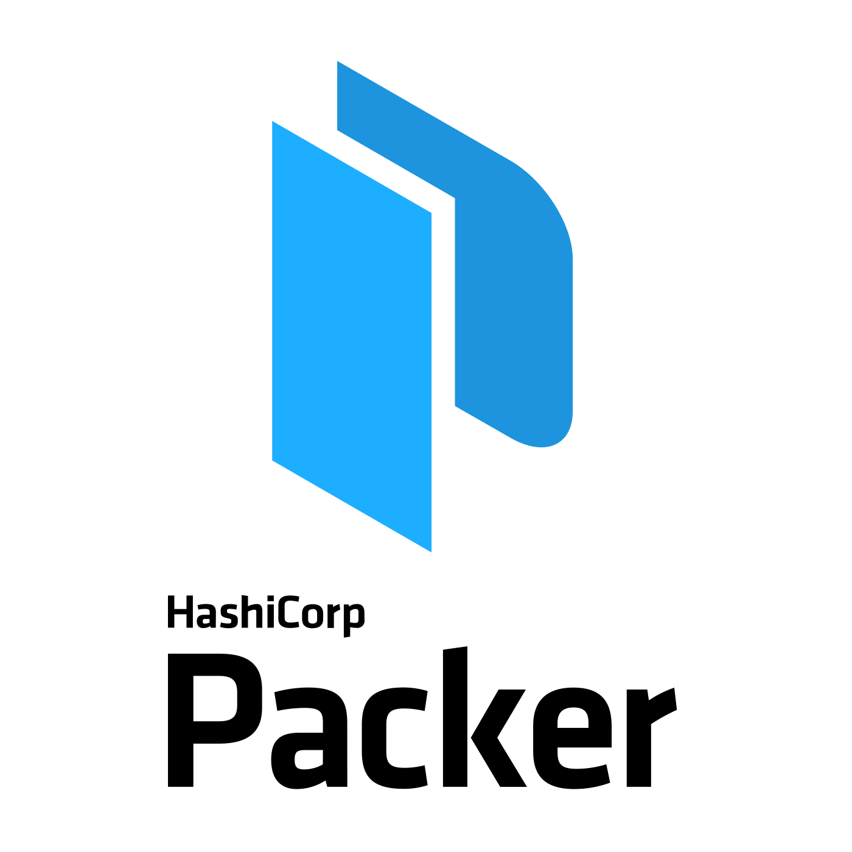
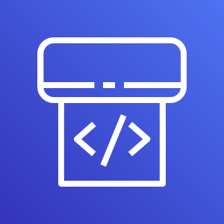
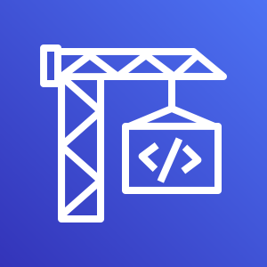

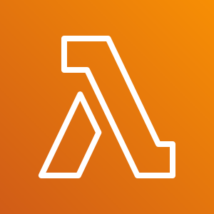
Question 1: Design a golden master AMI build work-flow identifying the key stages, and suggest technologies which might be used to implement. Use of AWS native services is preferred.
Github is best for SCM: AWS CodeCommit is still not as mature and is cumbersome to enable federated access , still requires a user with Access Keys, not the best from a security perspective.
AWS CodePipeline is used for CI/C:
CodePipeline will be triggered by webhooks from Github
Builds run on codebuild running packer container images
Packer uses public AMI ID committed and runs config scripts and creates a new AMI
Additional Automation:
AWS Lambda to share Golden AMIs between regions, can also trigger cloudformation stacks to update ASG’s with the new AMI
SNS topic for AMIs to be subscribed to by a lambda that can grab the new AMI ID and run the pipeline
AWS CodePipeline
AWS CodeBuild
Amazon Simple Notification Service
AWS Lambda

Slide 2


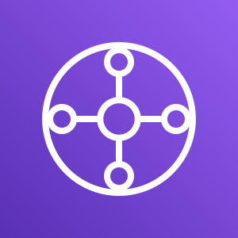


Question 2: Currently connectivity between AWS accounts and on premise networks are provided via peering and site-to-site vpn’s. Design a network topology that will allow scalable connectivity both across accounts and to on premise networks, and discuss: - Network migration strategies. - Security considerations and provisions.
Network Architecture is converted from a mesh architecture into a hub-and-spoke architecture. You can use Transit Gateways to consolidate your existing edge connectivity and route it through a single ingress/egress point, meaning that you can use one VPC to control ingress/egress connections to the internet, use one IGW in the shared-services account for example. AWS Transit Gateway is easily shared between different accounts and VPCs through Cloudformation(config is also done as part of AWS Landing Zone)
Network Migration Strategy:
New Network architecture can be established side by side with the current peering and VPN connections
New network is implemented the transit gateway, associating VPCs with it and Adding custom route tables as well as updating existing VPC routetables without disrupting network connections.
Network testing will be done to test the new routes deployed in the new architecture
Once connectivity has been established routes for peering connections can be disabled
Further testing is done to 100% connectivity is established
Peering routes can be removed
Peering connections can be removed
Security Considerations:
Security measures and provisions for the new networking architecture will not differ from the existing architecture
Security Groups and NACLs will not have to be changed
IAM doesn’t change between the two Network architectures
Ingress/egress points across multiple VPCs are consolidated into one
Amazon VPC
Amazon VPC
Amazon VPC
Customer gateway
VPN connection
AWS Transit Gateway
AWS Direct Connect

Slide 3
Question 3: Design an enterprise IAM solution to provide access to users, Applications, and services across the organization while ensuring controls are in place to ensure restrictions can be implemented on a least privileged requirement.
Zero-trust Architecture:
SSO with Adaptive MFA
Identity Aware Proxy
Network Micro-segmentation
Users & Identities:
User identities are managed via corporate identities like Microsoft AD or LDAP
Applications and Services Access:
SSO controls access to AWS resources by mapping different user groups to IAM roles with corresponding permissions based on least-privilege
SSO controls access to third party applications
Internal applications built on top of AWS can be configured to authenticate users through an OIDC compliant idp (OKTA) or through cognito userpools with Microsoft AD (Identity aware proxy)
VPNs aren’t used to allow access to business applications based on location, but rather for connecting two remote sites/can be replaced by direct connect

